Slide 1
Tutorial 6 Working with Tables and Columns

Slide 2
Objectives
Explore the structure of a Web table
Create headings and cells in a table
Create cells that span multiple rows and columns
Create row and column groups
Add a summary to a table

Slide 3
Objectives
Format a table using HTML attributes
Format a table using CSS styles
Collapse table borders
Display page elements in tabular form
Create a multi-column layout

Slide 4
Introducing Web Tables
Web table
HTML structure that consists of multiple table rows
Each table row contains one or more table cells. The cells can contain additional HTML elements such as headings, paragraphs, images and lists
Effective tool for organizing and classifying web page content
Consists of a table element

Slide 5
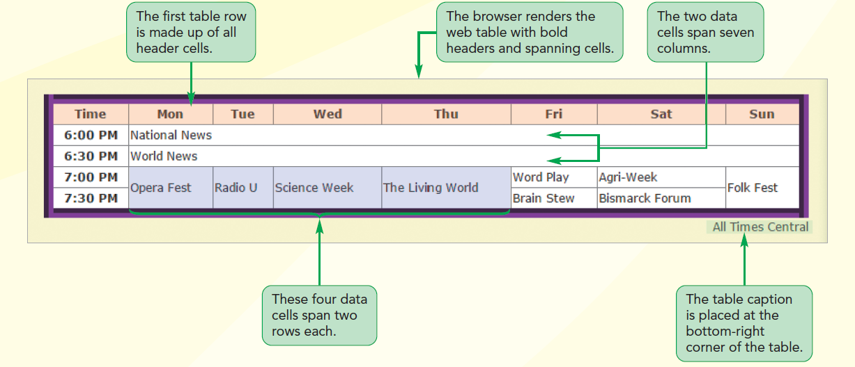
Structure of a Web Table

Slide 6
Marking Tables and Table Rows
A table element contains a collection of table rows marked using the tr (table row) element
A table contains cells within each row
Size of a table is defined by
number of table rows
number of cells within rows

Slide 7
Marking Tables and Table Rows
General structure of a web table:
<table>
<tr>
table cells
</tr>
<tr>
table cells
</tr>
…
</table>

Slide 8
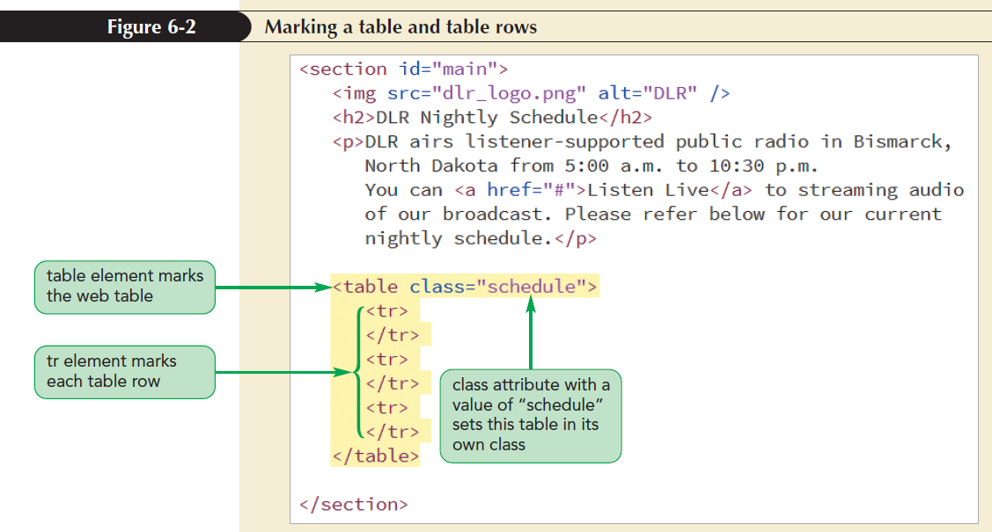
Marking Tables and Table Rows

Slide 9
Marking Table Headings and Table Data
Web tables support two types of table cells
Header cells
Contains content placed at the top of a column or beginning of a row
By default, displays text in bold and centers text horizontally
Marked using the th element

Slide 10
Marking Table Headings and Table Data
Data cells
Contains content within columns or rows
By default, displays text as unformatted text and is aligned to the left within the cell
Marked using the td element

Slide 11
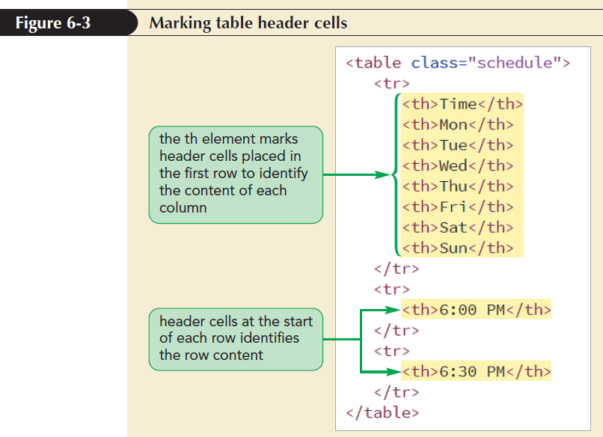
Marking Table Headings and Table Data

Slide 12
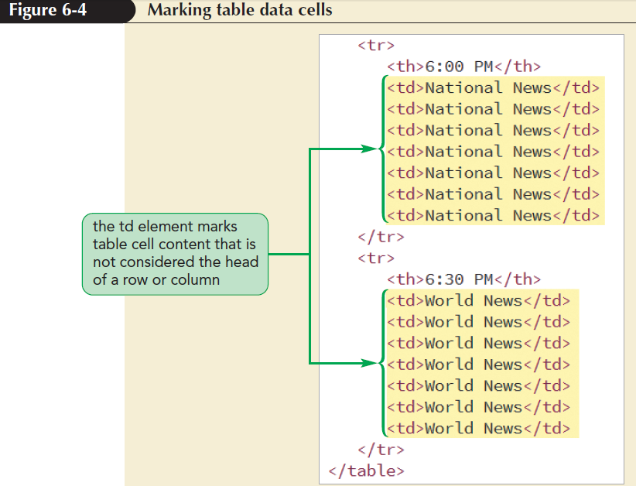
Marking Table Headings and Table Data

Slide 13
Adding Table Borders with CSS
The CSS border property is used to add borders to any part of a web table
Borders need not be of the same style
Two style choices for borders
Separate borders
Collapsed borders

Slide 14
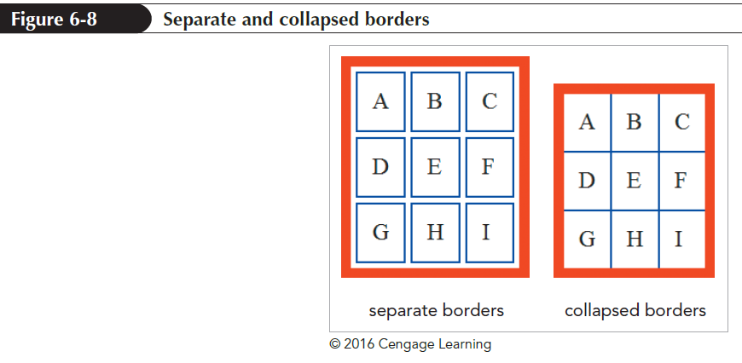
Adding Table Borders with CSS

Slide 15
Adding Table Borders with CSS
To choose between separate or collapsed borders model apply the following property to the table element:
border-collapse: type;
where type is either separate or collapse
The separate borders model sets the spacing between borders using
border-spacing: value
where value is in CSS units of measure

Slide 16
Spanning Rows and Columns
Spanning cells
Single cell that occupies more than one cell row and/or column
Created by adding rowspan and/or colspan attributes to td or th elements
Spanning starts in the cell with rowspan or colspan attributes and covers the cells in the right and below the initial cell

Slide 17
Spanning Rows and Columns
rowspan=“rows”
where rows is the number of rows that the cell occupies
colspan = “cols”
where cols is the number of columns that the cell occupies

Slide 18
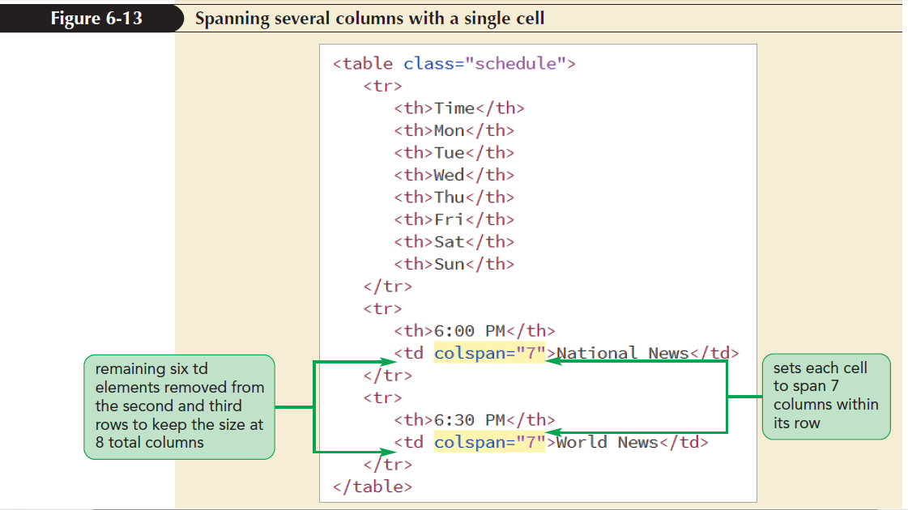
Spanning Rows and Columns

Slide 19
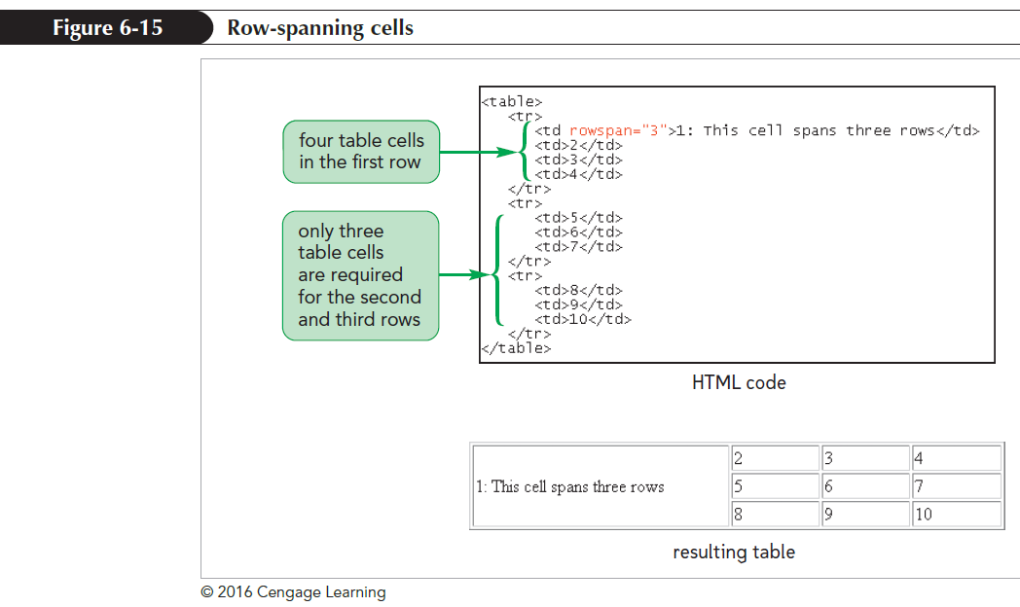
Spanning Rows and Columns

Slide 20
Creating a Table Caption
Table caption are marked using the caption element
<caption>content</caption>
where content is the content contained within the caption
Listed immediately after the <table> tag
Only one caption is allowed per web table
Inherits the text styles associated with the table

Slide 21
Creating a Table Caption
By default, captions are placed above the tables
To specify the location, use the caption-side property
caption-side: position;
where position is either top or bottom

Slide 22
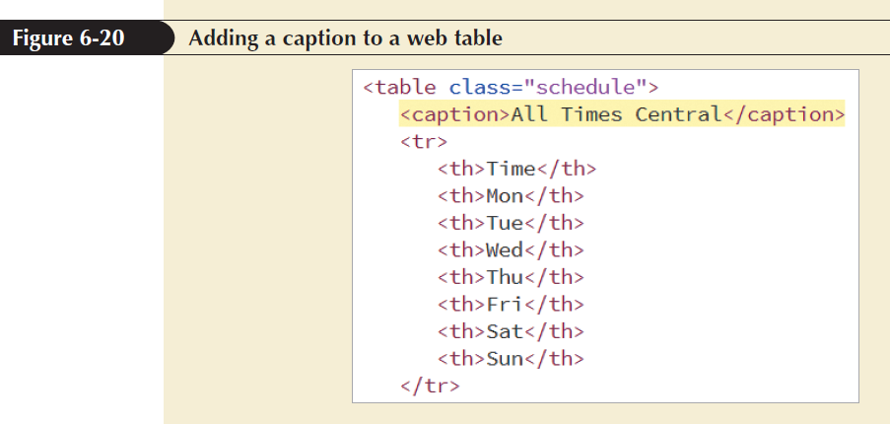
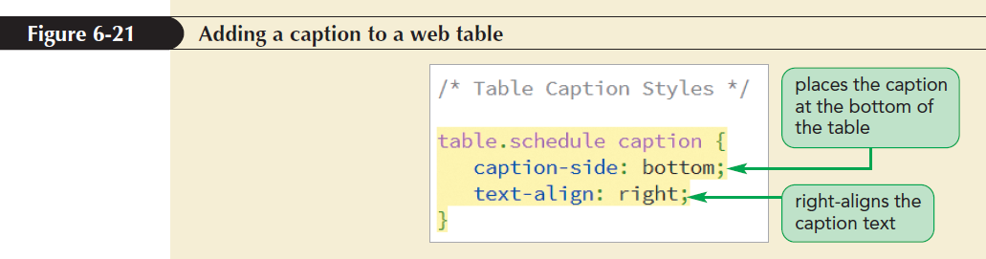
Creating a Table Caption

Slide 23
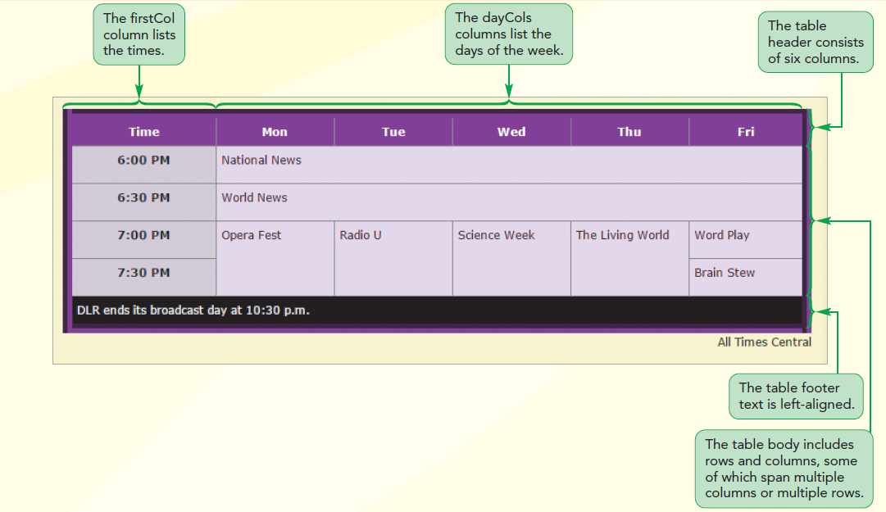
Rows and Column Groups

Slide 24
Creating Row Groups
Row groups contain specific table information
Allows to create different styles for groups of rows
HTML supports three row groups
Rows that belong to the table head
Marked using thead element
Rows that belong to the table footer
Marked using tfoot element
Rows that belong to the table body
Marked using tbody element

Slide 25
Creating Row Groups
The general structure of a web table divided into row groups
<table>
<thead>table rows</thead>
<tfoot>table rows</tfoot>
<tbody>table rows</tbody>
</table>
Only one thead and tfoot element is allowed per table but any number of tbody elements

Slide 26
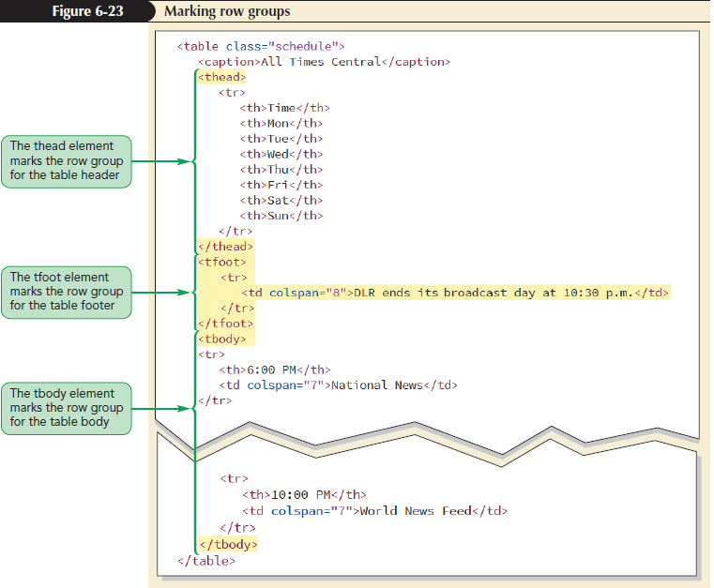
Creating Row Groups

Slide 27
Creating Column Groups
Columns are determined implicitly based on the number of cells within the table rows
Columns are identified by the col element
To identify individual columns, use the id and/or class attributes

Slide 28
Creating Column Groups
Columns can be referred using the following colgroup element:
<table>
<colgroup>
columns
</colgroup>
table rows
</table>
where columns are the individual columns defined within the group

Slide 29
Creating Column Groups
Columns and column groups accept only CSS style properties to modify
column borders
background
width
visibility

Slide 30
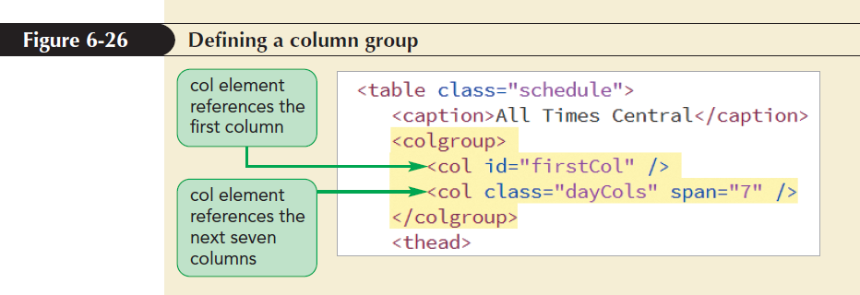
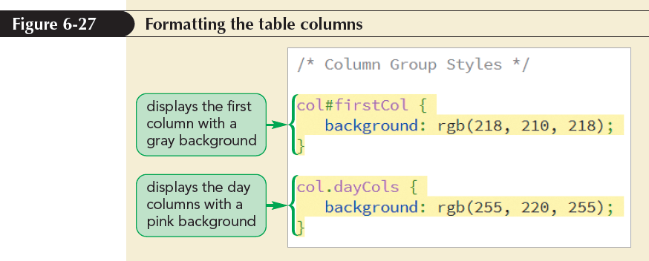
Creating Column Groups

Slide 31
Working with Width and Height
By default, browsers attempt to fit more content in each column before wrapping the cell text
Extra space is divided equally among columns if the width of a table is larger than its individual columns
Column widths are set using the width property
Col#firstCol { width : 16%;}

Slide 32
Working with Width and Height
The height of each row is based on the height of the tallest cell
A uniform row height is defined by applying the height style to table rows within each row group
The vertical-align property is used to move the cell text

Slide 33
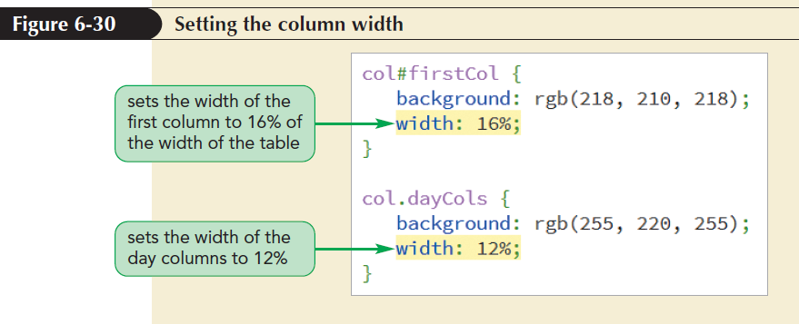
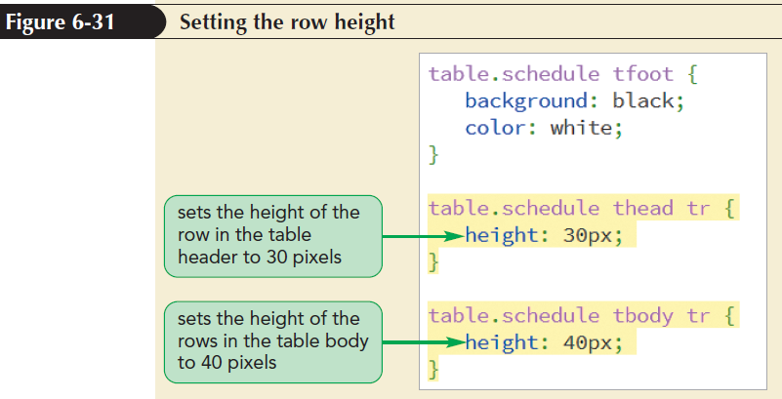
Working with Width and Height

Slide 34
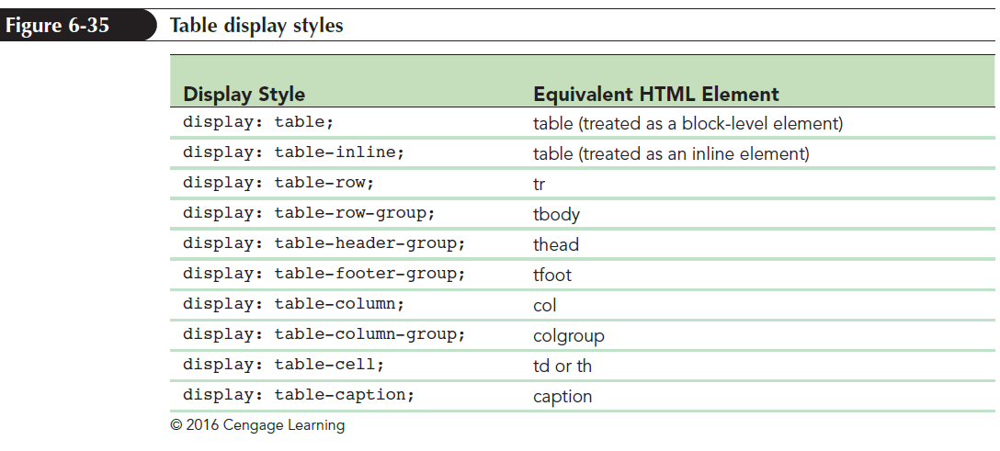
Applying Table Styles to Other Page Elements
Apply a table layout to other HTML elements (paragraph, block quotes or lists) using the CSS display property

Slide 35
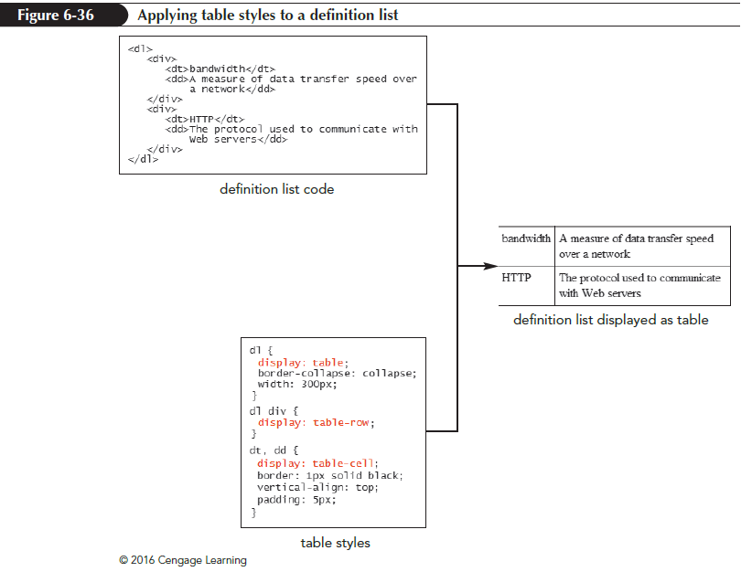
Applying Table Styles to Other Page Elements

Slide 36
Designing a Column Layout
Column layout enables display of content side-by-side in a page
Layouts that use float elements or flexboxes differ from column layout
Single element can flow from one column to the next
Flow of content adjusts to match the page width

Slide 37
Setting the Number of Columns
Size of a column is set using the column-count property
column-count: value;
where value is the number of columns in the layout
Browser extensions are included to ensure cross-browser compatibility

Slide 38
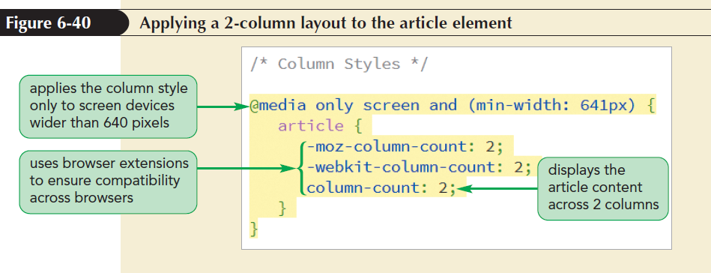
Setting the Number of Columns

Slide 39
Defining Column Widths and Gaps
Columns are laid out evenly across the width of the parent element by default
To set the column width, use the column-width property
column-width: size;
where size is the minimum width of the column
Column width acts like the basis value for items in a flexbox

Slide 40
Defining Column Widths and Gaps
The column-width and column-count properties are combined to form shorthand columns property
columns: width count;
The default gap between columns is 1em
To set a different gap size, use the column-gap property
column-gap: size;
where size is the width of the gap

Slide 41
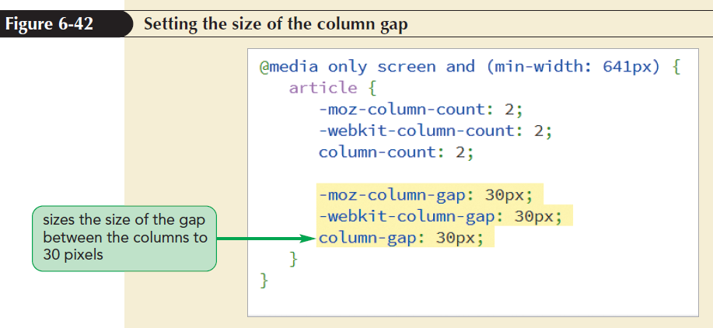
Defining Column Widths and Gaps

Slide 42
Defining Column Widths and Gaps
Another way to separate columns is with a graphic dividing line created using the column-rule property
column-rule: border;
e.g. column-rule: 1px solid red;
where border defines the style of dividing line
The column-rule property can be broken into individual properties like column-rule-width, column-rule-style, and column-rule-color

Slide 43
Managing Column Breaks
The size of column orphans is controlled using the orphans property
orphans: value;
where value is the minimum number of lines stranded before a column break
The size of column widows is controlled using the widows property
widows: value;
where value is the minimum number of lines placed after a column break
e.g widows: 3; orphans: 3;

Slide 44
Managing Column Breaks
Other properties to define column breaks
break-before: type;
break-after: type;
where type is one of the following:
auto (browser automatically sets column break)
always (to always place a column break)
avoid (to avoid placing a column break)

Slide 45
Managing Column Breaks
To control placement of column breaks within an element, use the property
break-inside: type;
where type is either auto or avoid

Slide 46
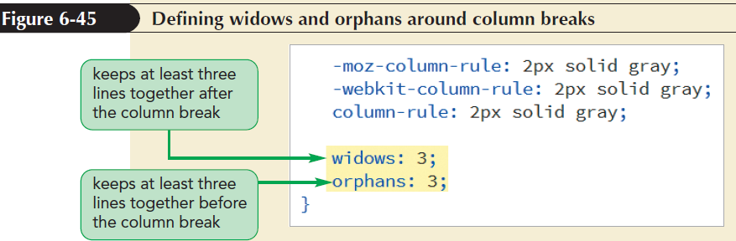
Managing Column Breaks

Slide 47
Spanning Cell Columns
To span cell columns, use the column-span property
column-span: span;
where span is either none to prevent spanning or all to enable the content to span across all the columns

Slide 48
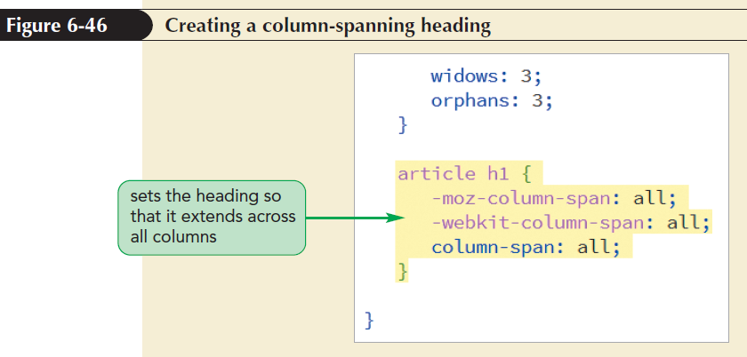
Spanning Cell Columns

Slide 49
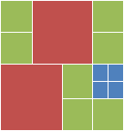
Table practice challenge

